Slide 1
Empowering Customers: Microsoft, Cloud and Open Source & Red Hat Update
Leon Jones
Director Open Source Sales & Marketing Strategy
Microsoft Corporation
Jim Zimmerman
Red Hat Alliance Lead
Microsoft Corporation

Slide 2


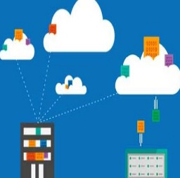

Agenda:
Empowering Customers: Microsoft Azure + Open Source
1
2
Red Hat + Microsoft Partnership Overview & Opportunity
3
Bringing it all together
4
Q&A

Slide 3

THE WORLD HAS CHANGED

Slide 4



PEOPLE
EMPOWER EVERY PERSON AND ORGANIZATION TO ACHIEVE MORE
INDUSTRIES
ORGANIZATIONS
Notes:
Download this deck’s script at http://aka.ms/commercialstory

Slide 5




CREATE MORE PERSONAL COMPUTING
PEOPLE
EMPOWER EVERY PERSON AND ORGANIZATION TO ACHIEVE MORE
BUILD THE INTELLIGENT CLOUD
REINVENT PRODUCTIVITY & BUSINESS PROCESSES
INDUSTRIES
ORGANIZATIONS
Notes:
Download this deck’s script at http://aka.ms/commercialstory

Slide 6
Our Open Source Strategy
Meet where customers are
Deliver the most productive and trustworthy cloud services platform that enables developers using any framework on any device or OS to create and power the world's apps and services that run anywhere
Best cloud platform for partners to succeed

Slide 7
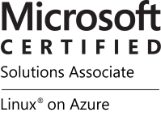
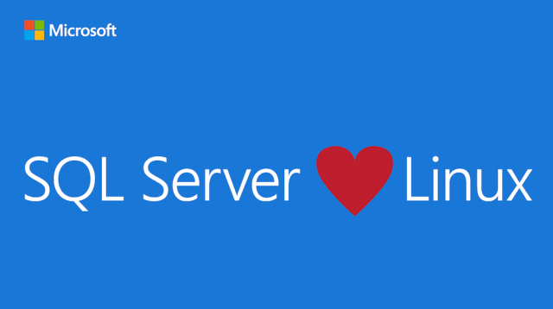
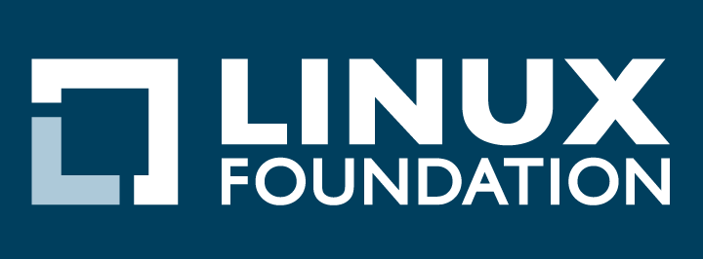


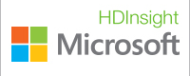


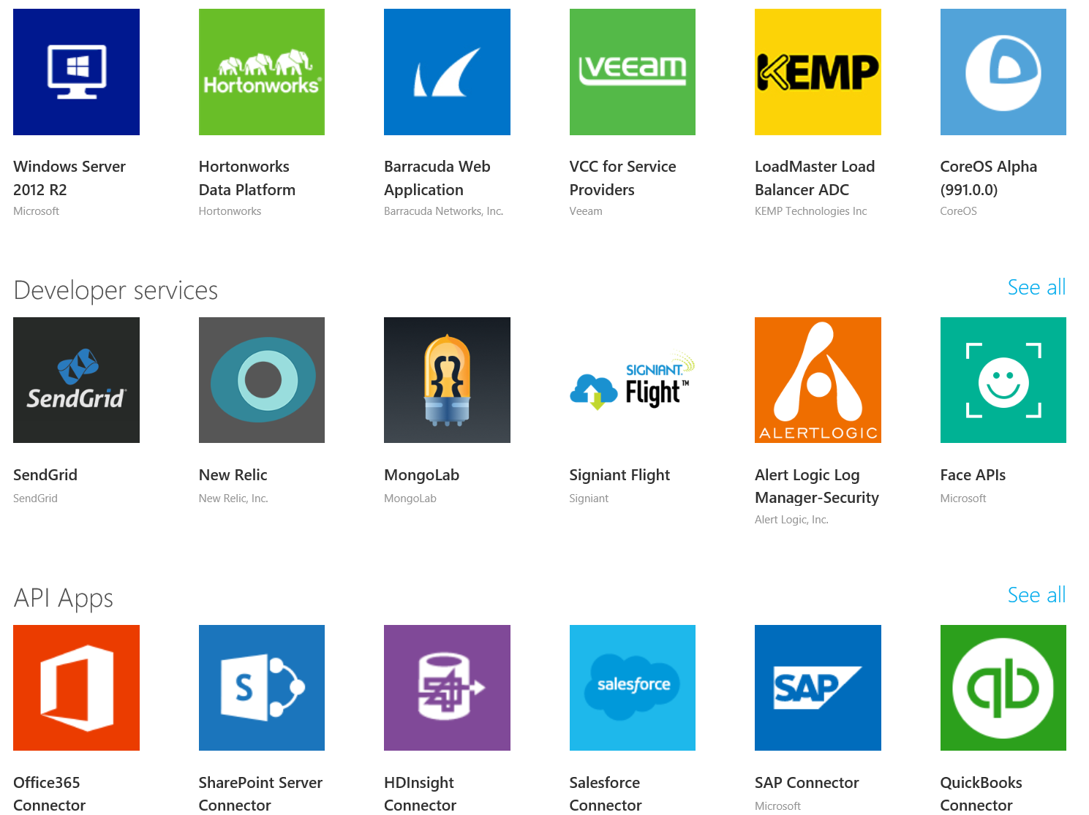
Momentum…
SQL Server on Linux
(Preview today, GA in mid-2017)
In partnership with the Linux Foundation, Microsoft releases the Microsoft Certified Solutions Associate (MCSA) Linux on Azure certification.
Red Hat - Microsoft Partnership
(Nov 2015)
Microsoft Employees
Ross Gardler: President Apache Software Foundation
Wim Coekaerts: Oracle’s Mr Linux
HD Insight PaaS on Linux GA (Sep 2015)
Microsoft joins Eclipse Foundation. (Eclipse is the largest OSS Dev Toolset)
(Mar 2016).
Azure Marketplace
60% of all images in Azure Marketplace are based on Linux/OSS
Windows Subsystem for Linux
Run Linux on Windows natively
(March 2016)
1 out of 4 VMs on Azure runs Linux, and getting larger every day
28.9% of All VMs are Linux
>50% of new VMs
1 out of 4 3
bash
467,484,471+
Lines Contributed
Open Source Hub

Slide 8
Developer & IT productivity
Hyper-scale
Open & flexible
Azure
Enterprise proven
Hybrid
Trustworthy
Platform for SaaS extensibility

Slide 9
Hyper-scale
Hyper-scale
Azure
Enterprise proven
Enterprise proven
Hybrid
Trustworthy

Slide 10

24
Azure regions around the world
Hyper-scale footprint
More than AWS and Google Cloud combined
Azure regions

Slide 11
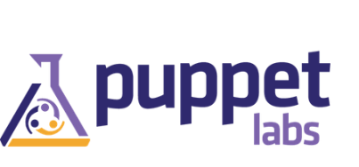



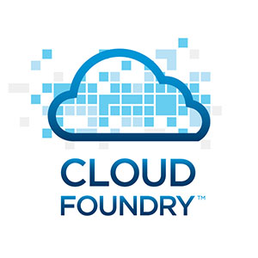
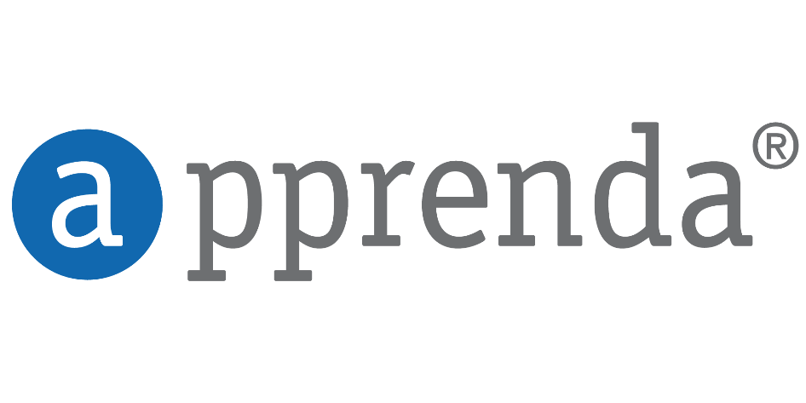

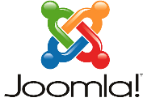




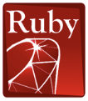


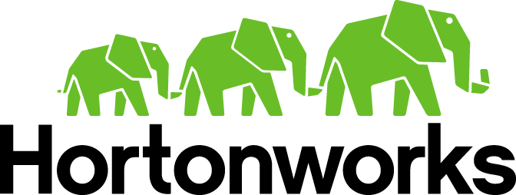



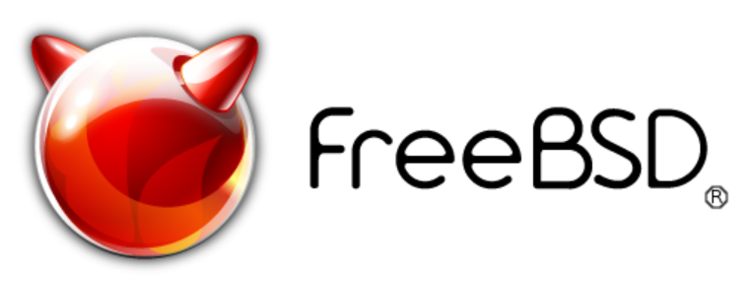


Open + Flexible
Developer & IT productivity
Management
Open & flexible
Open & flexible
Open & flexible
Hyper-scale
Open & flexible
Hyper-scale
Hyper-scale
Applications
Enterprise proven
Enterprise proven
Enterprise proven
App Frameworks
Hybrid
Trustworthy
Hybrid
Hybrid
Databases & Middleware
Platform for SaaS extensibility
Infrastructure
Linux

Slide 12
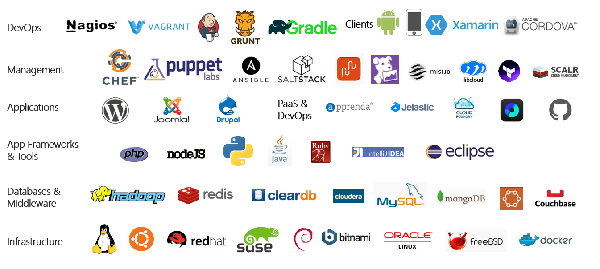
Azure is an open cloud
One in Four VMs on Azure Run Linux Today!
Notes:
P2

Slide 13
Hybrid
Hyper-scale
Open & flexible
Hyper-scale
Enterprise proven
Enterprise proven
Hybrid
Hybrid
Hybrid
On-premises
Azure Stack
Open Stack

Slide 14



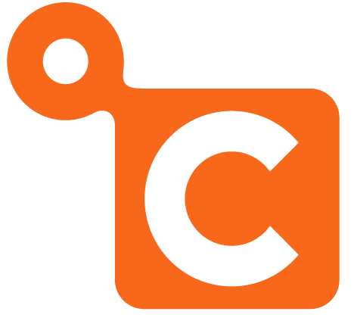

Dev + IT productivity
Developer & IT productivity
Developer & IT productivity
Developer & IT productivity
Visual Studio
GitHub
Eclipse
Chef + Puppet
Powershell
Open & flexible
Hyper-scale
Open & flexible
Hyper-scale
Enterprise proven
Enterprise proven
Hybrid
Trustworthy
Hybrid

Slide 15
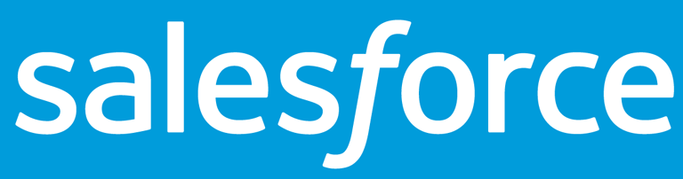
SaaS extensibility
Developer & IT productivity
Developer & IT productivity
Open & flexible
Hyper-scale
Open & flexible
Hyper-scale
Enterprise proven
Enterprise proven
Hybrid
Hybrid
Platform for SaaS extensibility
Platform for SaaS extensibility
Platform for SaaS extensibility

Slide 16
Azure: Leading the journey to the Intelligent Cloud
Cloud Infrastructure – SaaS Solutions – Higher Level Services
Power BI
Machine Learning
SQL Data Warehouse
HDInsight
Data Lake Analytics
Data Lake Store
Stream Analytics
Data Factory
Data Catalog
Event Hubs
Information management
Big Data stores
Machine Learning
Analytics

Slide 17
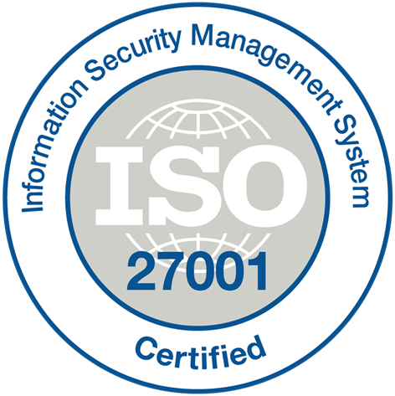
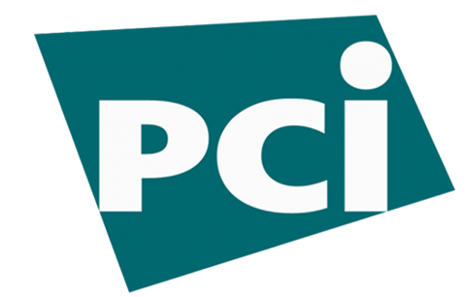
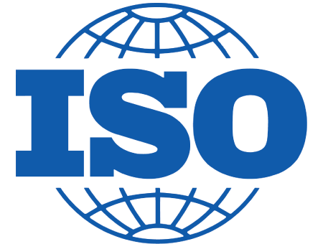
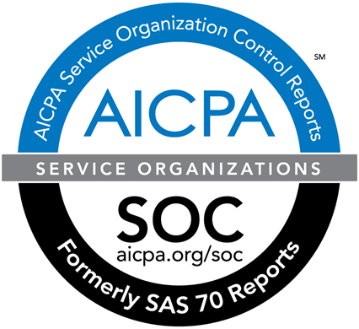

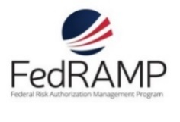




















Trustworthy
More compliance certifications than any other cloud
Developer & IT productivity
Hyper-scale
Open & flexible
Enterprise proven
Hybrid
Trustworthy
Platform for SaaS extensibility

Slide 18
>90,000
New Azure customer subscriptions/month
>1.5Million
SQL Databases running on Azure
>500Million
Users in Azure Active Directory
Azure Usage Momentum
1.5Trillion
Messages per month processed by Azure IoT
777Trillion
Storage Transactions per day
>40%
Revenue from Start-ups and ISVs

Slide 19


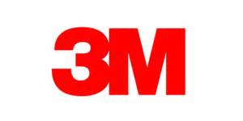










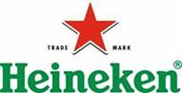


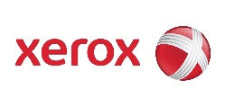






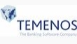


>80% of Fortune 500 now on Microsoft Cloud

Slide 20

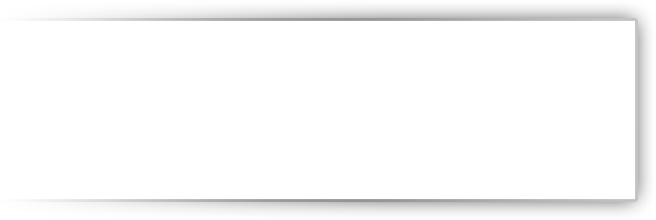


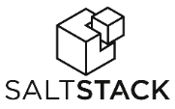



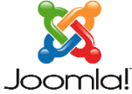
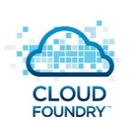
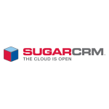



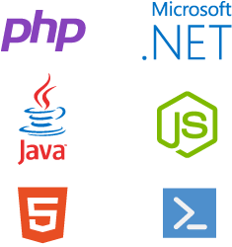


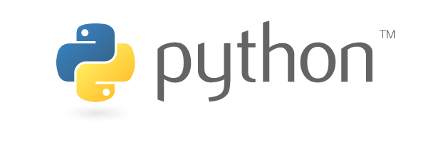




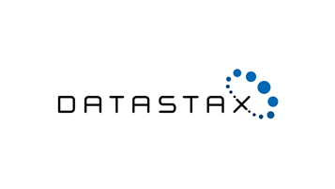
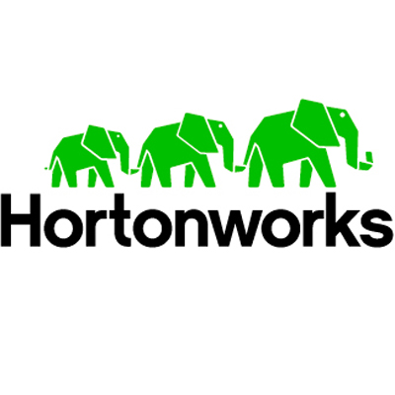
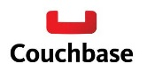
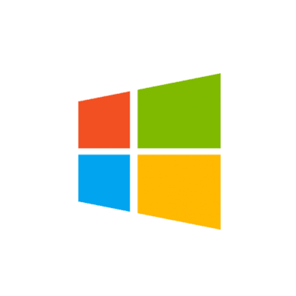

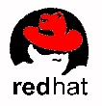


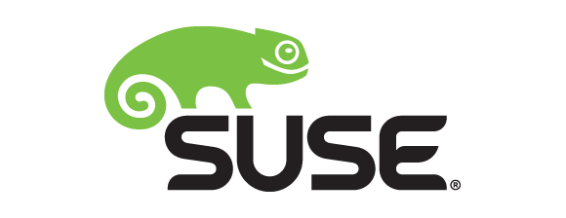

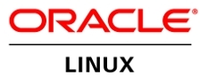
OLD partnership opportunity with Microsoft…..limited to our products
MS Product Centric
Management
System Center
Applications
Dynamics
SharePoint
Exchange
Application Frameworks
.NET
Databases
SQL Server
Infrastructure
Notes:
The reality is that in our industry, open source is pervasive. Just take a look at the technology stack – from the operating system up to the application, there are seemingly countless options in the open source space. Developers love open source, and the majority of those building new cloud based startups are also using open source technologies. Customers leverage it to be disruptive in their vertical, and our competitors are very effective in using it to capture share of wallet in the cloud.
Until now, we have successfully monetized a tight, vertically integrated family of technologies. But if we want a larger share of wallet in the cloud, it’s evident that we need to look beyond our only stack only and monetize open source technologies on Azure. By FY17 OSS is expected to represent an $18B opportunity in the IaaS and PaaS market. A large portion of private cloud and the majority of public cloud today is powered or influenced by open source.

Slide 21
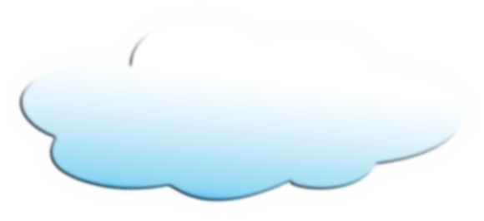
New Era for Microsoft…..with New Partnership Whitespace
Public Cloud
Hybrid Cloud
Private Cloud
Our Cloud Opportunity $$$
Management
System Center
Applications
Dynamics
SharePoint
Exchange
Application Frameworks
.NET
Databases
SQL Server
Infrastructure

Slide 22
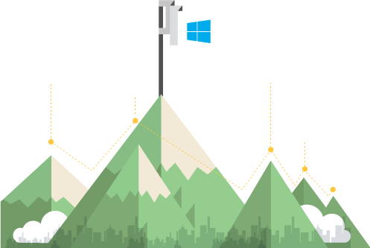






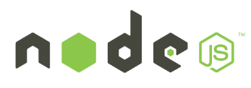





You & your customer’s journey to the cloud…..
Add value to your Linux investments
Embrace open source DevOps
Bring the tools you use and love
Build hyperscale at hyperspeed
Notes:
Everyone’s datacenter right now has a little bit of everything—it’s evolved over time, with new technologies and standards cropping up at all times (OSS and proprietary alike). This isn’t a bad thing—but it’s a management challenge for sure. How do we expect to oversee and manage this ever-evolving set of technologies and, specifically, the non-centralized open source technologies that are now ubiquitous?
Take a look through these technologies—some obviously will look very familiar to you and your evolving datacenter:
Oracle
SAP
Linux
Office
Windows
NodeJS
Apple
Java
Android
PHP
Hadoop
MongoDB
SharePoint
Hadoop
SQL Server
Drupal
Joomla
WordPress
.NET
Python
Dropbox
DB2
Puppet
Chef
GitHub

Slide 23
Azure + Open Source = $ for partners
Choose the best technologies for your solution in the cloud
Bring all your open source capabilities and assets to Azure to meet all your customer’s needs

Slide 24
Key Open Source on Azure Scenarios
Competitive and supportable today
Transform the Data Center
Enable Application Innovation
Data Insights
Manage Linux Infrastructure
Extending Data center Modernization with Linux
Linux testing on Azure
Linux Management with OMS (Log Analytics)
Linux Virtualization on Azure - Lift & Shift,
Linux Business Continuity and Disaster Recovery
Embrace any Application & Framework
Enterprise Web & LOB Apps - PHP, Java
Apps Dev/Test - Linux, Java and others
Dev Ops agility with OSS - Puppet, Chef, Docker
ISV Solutions from Marketplace - horizontal and vertical using open source
Embrace any Data Store
Data Pipeline: DB integration for exploratory Big Data -MySQL, Cloudera, MongoDB, Hadoop and others
+ many others……

Slide 25

Red Hat and Microsoft Partnership Overview & Opportunity

Slide 26
91%
“91% of enterprise IT decision makers expect to rely on hybrid cloud architectures by 2017.”
- Red Hat Hybrid Cloud Management Survey, IDC, October 2014
26
Notes:
There are 5 elements to this unique and deep relationship:
1) Integrated Support, both on and off premise with co-located support engineers to ensure that hybrid cloud customers an receive full support services covering both company's offerings in the hybrid cloud
2) Partnership on .NET for customers and ISVs where Red Hat will be shipping and supporting open sourced .NET with RHEL and OpenShift.
3) Availability and support of Red Hat offerings on Azure as well as extended support for Microsoft Windows on RHEL-OSP and RHEV
4) Integration of Red Hat Management offerings to support Microsoft Azure and System Center.
5) Inclusion of Microsoft as a Red Hat Certified Cloud and Service Provider enabling Azure as a trusted destination for customers to use Red Hat offerings.
26

Slide 27
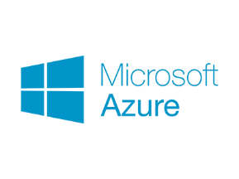


Cloud Innovation Presents Challenges
Integration with existing IT investments
Heterogeneous, complex landscape
Changing application architectures
27
Notes:
There are 5 elements to this unique and deep relationship:
1) Integrated Support, both on and off premise with co-located support engineers to ensure that hybrid cloud customers an receive full support services covering both company's offerings in the hybrid cloud
2) Partnership on .NET for customers and ISVs where Red Hat will be shipping and supporting open sourced .NET with RHEL and OpenShift.
3) Availability and support of Red Hat offerings on Azure as well as extended support for Microsoft Windows on RHEL-OSP and RHEV
4) Integration of Red Hat Management offerings to support Microsoft Azure and System Center.
5) Inclusion of Microsoft as a Red Hat Certified Cloud and Service Provider enabling Azure as a trusted destination for customers to use Red Hat offerings.
27

Slide 28
Why Partner Now?
Customers want…
Support and service for hybrid clouds, spanning heterogeneous technologies and architectures
New generation of application development capabilities from Microsoft and
Red Hat
Flexible, hybrid deployment and technology options
Portability and manageability
Confidence and choice in the enterprise cloud
28
Notes:
28

Slide 29
Strategic partnership between Red Hat and Microsoft
Integrated support services for hybrid clouds, including Red Hat® products in on-premise customer environments and on Microsoft Azure
Microsoft .NET integration and availability with Red Hat Enterprise Linux®, including Atomic Host, and OpenShift by Red Hat
Red Hat products offered and supported on Microsoft Azure
Microsoft Windows supported on Red Hat Enterprise Linux OpenStack® Platform and Red Hat Enterprise Virtualization
Management tooling integration for open hybrid cloud implementations with Red Hat CloudForms
Microsoft joins the Red Hat Certified Cloud and Service Provider program (CCSP)
29
Notes:
There are 5 elements to this unique and deep relationship:
1) Integrated Support, both on and off premise with co-located support engineers to ensure that hybrid cloud customers an receive full support services covering both company's offerings in the hybrid cloud
2) Partnership on .NET for customers and ISVs where Red Hat will be shipping and supporting open sourced .NET with RHEL and OpenShift.
3) Availability and support of Red Hat offerings on Azure as well as extended support for Microsoft Windows on RHEL-OSP and RHEV
4) Integration of Red Hat Management offerings to support Microsoft Azure and System Center.
5) Inclusion of Microsoft as a Red Hat Certified Cloud and Service Provider enabling Azure as a trusted destination for customers to use Red Hat offerings.
29

Slide 30
Delivering the hybrid cloud
Available
Today
Available
Today
Available
Today
Available
Today
Integrated support services for hybrid clouds, including Red Hat® products in on-premises customer environments and on Microsoft Azure
Microsoft .NET integration and availability with Red Hat Enterprise Linux®, including Atomic Host, and OpenShift by Red Hat
Red Hat products offered and supported on Microsoft Azure
Microsoft Windows supported on Red Hat Enterprise Linux OpenStack® Platform and Red Hat Enterprise Virtualization
Management tooling integration for open hybrid cloud implementations with Red Hat CloudForms
Microsoft joins the Red Hat Certified Cloud and Service Provider program (CCSP)
30
Notes:
Within one week of making this market-leading announcement, Red Hat and Microsoft delivered on 3 of the 5 major elements.
As we look to the future, we are committed to supporting enterprise customers and ISVs as we make the migration to the enterprise cloud.
30

Slide 31

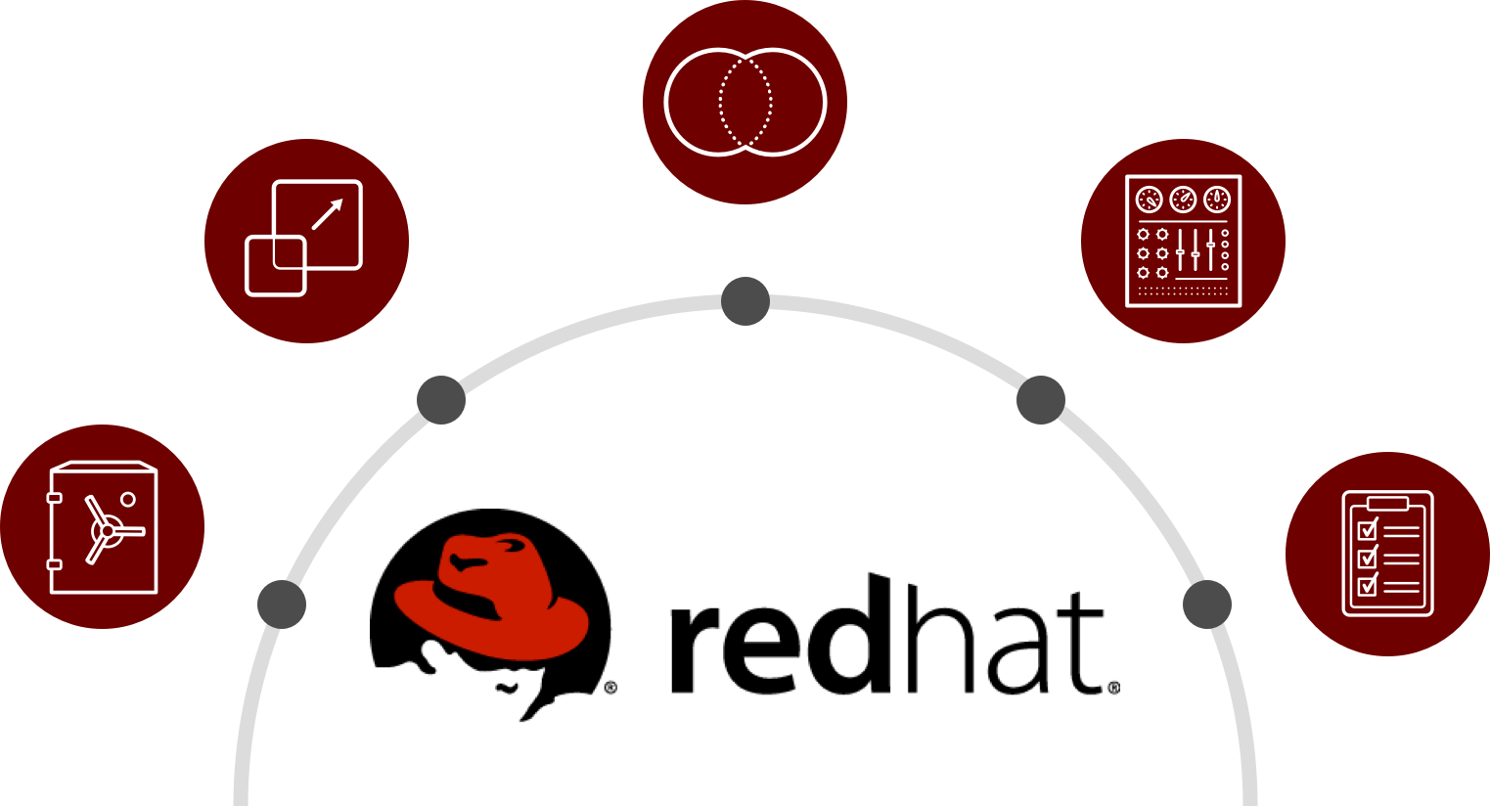

Infrastructure Without Boundaries
Modern IT infrastructures need the flexibility to respond to rapidly changing business demands and technology landscapes, while at the same time must be secure, reliable, and manageable enough to support mission-critical workloads.
Notes:
Infrastructure without boundaries is all about Efficiency, Flexibility and Agility allowing companies to innovate incrementally without losing control or compromising security. Also allowing companies to utilize and optimize existing resources across physical, virtual, private, and public cloud environments. The need to evolve and modernize existing infrastructures is driving businesses to adopt Hybrid Cloud technologies that can remove existing barriers to success while at the same time can provide the reliability, performance, and security expected by enterprises today.
Red Hat and Microsoft are responding to customer demand for modern, open, and agile infrastructures that work well in today’s increasingly complex Hybrid IT world.

Slide 32


Enterprise Operating System
Guidance
Look for | Pent-up demand from customers who have been waiting for Azure support Customers who need enterprise-grade support for Linux workloads in a public cloud Microsoft and Azure enterprise customers using other, often-unsupported Linux distributions
Win by | Highlighting the value of Red Hat Enterprise Linux in Azure: Joint, Integrated Enterprise-grade support Consistent hybrid cloud management (CloudForms) Flexible consumption (On-demand & BYOS) Secure, stable & modern platform for hybrid clouds Cost savings from consistency and standardization
Don’t | Don’t forget to discuss the value of the entire Red Hat and Microsoft portfolio from Infrastructure through Application Frameworks Don’t focus on zero-sum use cases like Lift and Shift Don’t forget that our partnership will grow and evolve over time to include even more value for enterprise customers
Red Hat Enterprise Linux is the trusted, open source operating system that enterprise customers across the globe rely on to run their business-critical workloads.
Subscription flexibility with Red Hat Cloud Access
Marketplace Images on-demand
Foundation for next-gen architectures
Notes:
Both Red Hat and Microsoft customers have been asking for the availability of RHEL in Azure for some time now. Now our joint customers can choose how they want to deploy RHEL - migrate existing RHEL subscriptions to Azure (BYOS) via the Red Hat Cloud Access program, or leverage the flexibility of RHEL on-demand via the Azure Marketplace. Either way, customers can be sure that they are backed by enterprise-grade support from Red Hat and Microsoft.
Enterprise Hybrid Cloud infrastructures are built using common platforms, standards, and tools that work well on-premise and in the cloud. Red Hat Enterprise Linux is a trusted, open source operating system that enterprise customers across the globe rely on to run their business-critical Linux workloads.
Customers who rely on RHEL in their datacenters today, can now run the same trusted operating system in Azure with a choice of deployment models that best meets their needs.
Extend datacenter capacity with Bring-Your-Own-Subscriptions (BYOS) to Azure via the Red Hat Cloud Access program while maintaining existing support relationship directly with Red Hat
Utility computing via on-demand images in the Azure Marketplace with pay-as-you-go pricing
Modern Linux operating system designed as the foundation for the latest technology trends such as microservices and containers
All enterprise Linux workloads in a trusted public cloud

Slide 33

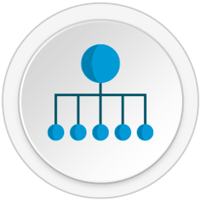




Hybrid Cloud Management
Guidance
Look for | Customers with hybrid and multi-cloud infrastructures that lack consistent management tools Customers wanting a single tool for managing Windows and Linux workloads across their hybrid cloud Red Hat customers who want advanced visibility and control of container and OpenShift environments
Win by | Highlighting the value of Red Hat CloudForms in Azure: Azure ARM support Integration with System Center VMM provides lifecycle management both on-premise and in Azure Ability to manage other Red Hat solutions in Azure such as OpenShift Advanced hybrid cloud workload placement and SmartState analysis capabilities (coming soon)
Don’t | Don’t focus on “vs.”, instead emphasize how CloudForms integrates, extends, and enhances existing System Center environments Don’t forget that Azure will be the first public cloud environment featuring advanced SmartState analysis capabilities (v4.1) from Red Hat CloudForms Don’t forget about workloads, CloudForms manages infrastructure, apps, and workloads e.g. SQL, AD, etc.
Red Hat CloudForms is a cloud management platform that offers the control and automation capabilities IT staff need to effectively manage increasingly complex hybrid infrastructures.
Hybrid Cloud Management Platform
Intelligent Hybrid Cloud Brokering with Azure
System Center Integration
Notes:
Managing a complex, hybrid IT environment can require multiple management tools, and extra staff to handle operations.
Red Hat CloudForms is a unified management platform for hybrid cloud environments that offers the control and automation capabilities IT staff need to effectively manage increasingly complex hybrid infrastructures. Red Hat CloudForms can discover, control, and manage private and public cloud infrastructures made up of scale-up enterprise virtualization platforms, scale-out OpenStack cloud infrastructures, and public clouds including Azure. Today, existing customers can extend management into Azure and integrate CloudForms with their existing management tools to create a truly unified Hybrid Cloud management platform.
In the future, CloudForms 4.1 will introduce expanded Hybrid Cloud management capabilities for Azure that will include Smart State analysis making Azure the only public cloud with this capability.
Bring existing subscriptions to Azure via the Red Hat Cloud Access program while maintaining existing support relationship directly with Red Hat
CloudForms 4.0 expands its managed platform support to include Azure (ARM) providing core lifecycle management capabilities for those workloads
Self-service provisioning of Azure resources
Intelligent cloud brokering to control VM placement
Unified management with Microsoft System Center VMM & Operations Manager integration
(Future) CloudForms 4.1 with expanded Hybrid Cloud management capabilities for Azure including Smart State analysis

Slide 34

Hybrid Storage
Guidance
Look for | Customers searching for an open, scalable, software-defined storage solution for hybrid cloud environments Customers who need a POSIX compatible solution to ease migration of Linux workloads to Azure while avoiding costly rewrites Target use cases include: Machine Analytics (Splunk), Big Data (Hadoop), Media Streaming, Enterprise File Sharing, Data Archival, Geo-replication for DR
Win by | Highlighting the value of Red Hat Gluster Storage in Azure: Simple to install and configure with a minimal footprint Leverages Azure Availability Sets for data availability during planned or unplanned outages Asynchronous, multi-region data replication with support for on-premise to Azure hybrid use cases Advanced features built-in: Snapshots, Quotas, Erasure Coding, and Intelligent Tiering
Don’t | Don’t ignore opportunities to challenge customer’s perception of lock in to other public clouds on storage and data Don’t underestimate the value of POSIX compatibility for Linux applications in Azure Don’t forget that unstructured data is the fastest growing type of data in the enterprise today
Red Hat Gluster Storage is the reliable and cost-effective, storage solution that’s engineered for Hybrid Cloud environments to deliver rich functionality without rigid hardware dependencies.
Scale-out & Scale-up cloud storage in Azure
Rich Media & Archival
File sync & share
Notes:
Companies today rely on data now more than ever before. Data is a key enabler for business innovation delivered through technologies such as business analytics, data mining, and content delivery.
Red Hat Gluster Storage offers a scale­-out, POSIX compatible, massively scalable, elastic file storage solution in Azure which can be used for multiple use ­cases including archival, rich media streaming, big data analytics, and geo­-replication for disaster recovery. Red Hat Gluster Storage on Azure enables customers to deploy consistent storage technology on-premise and in Azure allowing existing applications to be migrated to cloud more easily. Traditional hardware storage solutions do not offer this level of flexibility – open, software-defined storage can provide the level of compatibility and agility required for hybrid cloud infrastructures.
Red Hat Gluster Storage solutions in Azure provide a foundation for customers to build cloud-ready business services such as Big Data, Analytics, Rich Media, Data Sync & Share, Cloud Infrastructure, Virtual Machine Storage, and much more.
Bring existing subscriptions to Azure via the Red Hat Cloud Access program while maintaining existing support relationship directly with Red Hat
Build reliable, scale-out cloud storage clusters (2TB to 800TB) that can be shared between multiple applications
Easily migrate existing data and applications from on-premise to Azure with built-in POSIX compatibility
Native client support as well as NFS in the first release, existing applications that rely on file interfaces while moving to the public cloud will benefit the most by avoiding expensive rewrites.
Create disaster recovery environments for on-premise applications and data using asynchronous geo-replication capabilities
Supports Linux and Windows operating systems

Slide 35


Hybrid Application Framework
Guidance
Look for | Customers wanting an open PaaS solution that includes next-gen features like Docker containers, Kubernetes orchestration, and supports enterprise CI/CD workflows Java users looking for a consistent platform to run their business applications in Azure Customers building microservices architectures in the public cloud Customers using the hybrid cloud to develop business applications faster and accelerate time to market
Win by | Talking to developers about the value of a common platform for building, deploying, and managing apps across hybrid cloud environments Promoting the integration of Azure services and .NET within OpenShift and RHEL enabling delivery of business value to existing and next-gen applications Understanding the shift from monolithic application models to more agile, scalable, and resilient microservices
Don’t | Don’t limit discussions to just .NET applications on Windows or Java on Linux – both platforms are fully supported on Azure Don’t forget to discuss the concepts and value of Agile software development – standardize, automate, continuous improvement Don’t forget that customers can use Red Hat CloudForms to manage OpenShift container environments in Azure
OpenShift by Red Hat and Red Hat JBoss Middleware enable developers to build, integrate, and deploy cloud-native applications and open Red Hat’s award-winning application middleware, development & deployment solutions in Azure.
Built on an Enterprise Grade Platform
Comprehensive suite of application services
Natively integrated Docker containers
Notes:
The ability to build and run OpenShift Enterprise PaaS environments on Azure offers choice, flexibility, and standardization. Customers will be able to choose Microsoft Windows for Windows containers, and Red Hat Enterprise Linux Atomic Host and OpenShift for certified Red Hat Enterprise Linux containers unified by the common .NET framework.
Collaboration on .NET will enable a new generation of application development capabilities. Developers will have access to .NET technologies across Red Hat offerings, including Red Hat OpenShift and Red Hat Enterprise Linux. With a host of .NET applications already deployed throughout enterprises, customers want the ability to to build .NET applications on infrastructure powered by RHEL.
Red Hat JBoss Middleware is the ideal middleware portfolio for open hybrid cloud environments. JBoss solutions allow customers to accelerate application development, deployment, and performance, integrate data and applications efficiently, and automate business processes across physical, virtual, mobile, and cloud environments. JBoss Enterprise Application Platform (EAP) is the foundational component for the JBoss middleware family. It’s flexibility allows deployment to physical, virtual, and cloud environments. JBoss Enterprise Web Server (EWS) removes the complexity from managing open source-based web application environments by including all of the popular open source technologies - Apache Web Server, Apache Tomcat, and common connectors - for building, deploying, and maintaining web applications and large-scale websites.
Our integrated solutions are designed to meet the current and future needs of enterprise customers with features that allow developers to focus on building the best possible applications and leave the management and orchestration of the infrastructure to the system. OpenShift is designed for the future - as modern applications continue the shift to microservices architectures, the infrastructures that host them must be able to flexible and scalable enough to efficiently run and manage the increasingly complex system of interconnected and distributed application containers.

Slide 36




Integrated Support
Red Hat and Microsoft have created an industry-changing integrated support model for customers using Red Hat solutions in Azure. We are working side-by-side to solve common problems and to provide the enterprise-grade support that customers rely on in their datacenters.
Highlights:
Red Hat participation in Azure forums
Red Hat & Microsoft security response team collaboration
Support staff from Red Hat & Microsoft co-located @Redmond
Integrated ticketing systems
Red Hat Technical Account Management & Microsoft Premier Services

Slide 37

Microsoft Technology Centers
Technology initiatives can transform your business, but they can also stall or end in disaster. How can you ensure your technology investments payoff by creating new businesses, enabling your employees to be more productive or open new channels to engage with your customers?
There are over 30 MTCs across the globe to help you transform your business in a mobile-first, cloud-first world.
Empowering every person and every organization on the planet to achieve more.
Envision
From straightforward projects to complex business transformations, we’ll help you reimagine your enterprise in this platform and device rich landscape.
Differentiate
Together we will explore your business challenges and evaluate potential technology solutions to help you compete and win in the digital age.
Design
We’ll help you architect secure, reliable solutions that align with your business processes, scale to meet your needs and integrate with your existing technologies.
Incubate & Accelerate
Whether it’s incubating a new idea, experimenting with new technology or proving out a solution we have the process, and people to get you there faster.
Immerse
The rate of return on technology is the rate that your employees and customers adopt it. Interact with our technology to experience first hand how we can empower your people to be more responsive, agile and customer obsessed.
Virtual
Augment your in-person experience with live webinars and on-demand content delivered by MTC experts. Stay current on technology topics at your convenience, your place on your device.
To explore the potential impact of cloud, mobile & social solutions to your business with an MTC engagement and get a list of upcoming and on demand MTC Studio sessions, go to www.microsoft.com/mtc or contact your account manager.
Empower. Innovate. Transform.
Notes:
Speaker Script:
The Microsoft Technology Center (MTC) is an immersive environment that enables and empowers our customers to make better decisions. Our combination of
PEOPLE (leading architects),
PROCESS (Briefings, Architectural Design Sessions, POCs, Workshops) and
PLACE (access to cloud, on-prem and hybrid compute resources, a state of the art facility to enable collaboration and access to a variety of expertise) help deliver platform solutions.
85% of Microsoft’s enterprise customers are within 100 miles of an MTC.
It is a resource for our partners to consider as their own. For partners, it has been proven (for nearly 15 years) to accelerate deal velocity, create larger deals and offer the opportunity to architect and design solutions that exactly meet the needs of our common customers.

Slide 38
Microsoft’s Bold Ambitions
MTC Briefings and Technology Sessions
Executive OSS Level Strategy Briefings
Build the Intelligent Cloud Platform
Atlanta
Boston
Charlotte
Chicago
Dallas
Detroit
Houston
Irvine
Los Angeles
Minneapolis
Montreal
New York
Philadelphia
Reston
Silicon Valley
St. Louis
Toronto
■ | Understanding and Building the Intelligent Cloud Platform
■ | Linux Systems Management with Puppet, Chef, and PowerShell DSC
■ | How to Implement Containerization with Docker
■ | Large Scale Production Linux Deployment strategy
■ | Red Hat Open Shift on Azure
■ | Cyber Security Envisioning Experience
■ | Understanding Microsoft’s Azure Data Centers – Data Center Tour
Cloud Infrastructure and Enterprise Mobility
■ | ■ | ■ | ■ | Manage a Hybrid Cloud Environment – System Center, Hyper-V, Azure, VMware, and OpenStack
■ | ■ | ■ |  | Datacenter Automation – PowerShell, Azure Automation, Chef, Puppet
■ | ■ | ■ |  | Branch Office Transformation – Hyper-V, StorSimple, System Center
■ | ■ | ■ |  | Azure StorSimple, Azure Site Recovery and Azure Backup: Better together
 |  |  | ■ | Hybrid Identity – EMS, AAD, AuthN, AuthZ
 | ■ | ■ | ■ | AWS, VMware, OpenStack - Achieve High Availability and Disaster Recovery with Azure Site Recovery
Reinvent Productivity & Business Processes
■ | ■ |  |  | Red Hat Open Shift Overview and Deployment
■ | ■ |  |  | Modern Heterogeneous Workplace
■ | ■ |  |  | Continuous deployment with Jenkins
■ | ■ | ■ |  | Using Drupal and WordPress for website management
 |  |  | ■ | Reinventing Productivity and Business Processes
■ | ■ | ■ | ■ | Empowering developers with Self-Serve Test Environments
 |  |  | ■ | Deploying Red Hat
Data Analytics, Internet of Things and Application Platform
■ | ■ | ■ | ■ | Cortana Analytics Suite
■ |  |  |  | Health Analytics Strategy Briefing
 | ■ | ■ | ■ | SAP integration with Microsoft Business Analytics
■ | ■ | ■ |  | Analytics Platform System
 | ■ | ■ | ■ | Azure SQL Data Warehouse and Azure SQL Database Architecture Design
 |  |  | ■ | Elastic Search, MySQL, and MongoDB databases
 |  |  | ■ | Practical Machine Learning with Azure ML Revolution R
Create More DevOps Computing
■ |  |  |  | Azure CLI, Managing Azure from Linux and Mac
■ | ■ |  |  | Deploying Red Hat Enterprise Linux
■ | ■ |  | ■ | Understanding Azure Hyper-Scale for Linux workloads
■ |  |  | ■ | OSS Web Stack – Apache, Nginx, MySQL, MongoDB
■ | ■ | ■ | ■ | Developing Modern Applications with PHP and Java
Each MTC engagement is tailored to meet your customer’s specific needs. If you don’t see what you are looking for, contact your Microsoft Account Executive or Microsoft Partner representative.
Legend:
Workshop (1 Day)
Design (2 Days)
Proof (3-5 Days)
Briefing (1 Day)
Notes:
We have defined several engagements at the Microsoft Technology Center (MTC) with Microsoft Technology Architects, Red Hat Solutions Architects as well as our ecosystem of partners that will build trust with our common customers, accelerate deals and grow your business.
The Process that the MTC provides uses includes four key engagements that Microsoft and Red Hat are committed to delivering together:
Strategy Briefing – Envision the art of the possible. Create an understanding of the Azure and Red Hat capabilities through presentations, white board discussions and demonstrations. Define the strategy and architecture for possible solutions.
Architecture Design Session – Design and architect a solution. Provide a conceptual architecture.
Proof of Concepts & Hackathons – Apply designs and architectures in Azure in a POC.
Workshops – Hands on labs.

Slide 39
Fee Structure for Partners - RedHat on Azure
Draft Guidance
FEES THAT PARTNERS CAN RECEIVE WHEN CUSTOMERS USE RED HAT ON AZURE
Bring-Your-Own-Subscription (BYOS)
Pay-As-You-Go (PaYG, via Azure Marketplace)
When partners sell Red Hat subscriptions, that customers move to Azure, partners receive fees via two ways:
From Red Hat: regular fees paid by Red Hat for the subscriptions sold/renewed. Paid as usual.
From Microsoft: consumption fees paid by Microsoft (20% of what the customer consumes on Azure). Paid monthly/quarterly.
If customers use existing Red Hat subscriptions (i.e. not new ones) for Azure, partners still receive the 20% fees from Microsoft based on Azure consumption.
When customers buy RHEL VMs from the Azure marketplace (PaYG model), partners receive fees directly from Microsoft:
From Microsoft: consumption fees paid by Microsoft (20% of what the customer consumes on Azure). Paid monthly/quarterly.
PaYG model is expected for customers that want to test Azure for RHEL workloads or have varying capacity requirements, as it provides flexibility (pay per hour) and rapid deployment. However customers are expected to buy through traditional channel for established environments.
Running Red Hat on Azure represents additional revenue for partners via 1.- incremental fees paid by Microsoft (20% based on customer Azure consumption) and 2.- additional subscriptions that customers buy to use on Azure.
Note: to be eligible for Azure consumption fees, partners need to join Microsoft’s Cloud Solution Provider (CSP) Program

Slide 40
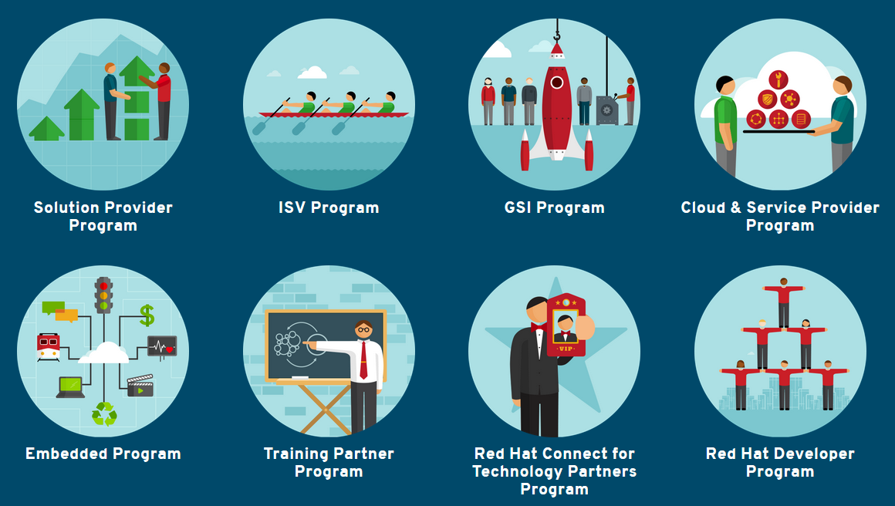
Partnering to win with Microsoft & Red Hat
Partner with Microsoft and become an Azure Partner:
Cloud Solution Provider Program
Open Licensing
Azure Marketplace Partner
To sign-up, register on MPN: aka.ms/redhatpartners
Red Hat Connect for Business portal provides you with:
Self-selecting into any number of partner relationships with Red Hat.
To learn more, visit Microsoft Partner Network:
Insights and tools to build a profitable business plan for the cloud
aka.ms/cloudprofit
Training to strengthen your capabilities
aka.ms/noyxnr
Marketing guidance and resources to reach more customers
aka.ms/x9c0mq
Communities of experts to help you scale your business
www.yammer.com/mpncloud

Slide 41
Microsoft + Red Hat National Event Series
Purpose
Leverage the events to build relationships with local Microsoft and Red Hat local sales teams as well as drive your customers to attend.
Event Agenda
Partner Sessions | 9:30-11:30am + Lunch Customer Sessions | 2:00-4:00pm + Happy Hour
Kickoff | Local lead
Empowering Customers: Microsoft + Open Source | MSFT speaker
Red Hat and Microsoft Partnership Overview | RH speaker
Solving Hybrid Cloud needs | RH speaker
Bringing it all Together | MSFT speaker
Q&A Panel | All speakers
Event Dates
City | Date
Atlanta | Apr 28
Detroit | May 10
Orange County (Irvine) | May 11
NYC | May 11
Bellevue (Bravern) | May 12
Dallas | May 17
DC | May 17
Phoenix | May 18
Boston | May 19
Chicago | May 24
Mountain View | May 28
22 events across 11 cities; Each city to host one partner event and one customer event
For more details and to register:
http://aka.ms/intelligentcloudevents

Slide 42
Calls to Action – Red (Hat Specific)
1
Join Microsoft Partner Network and Red Hat Connect for Business.
2
Inform your customers about the Microsoft + Red Hat relationship and the hybrid cloud solution.
3
Schedule a strategy briefing workshop at the MTC to learn, scale and drive your business.
4
Sign-up and invite your customers to the Open Source on Azure Webinar series and MS+Red Hat National Events.
5
Participate / Attend in Events coming up:
Red Hat Summit, June 27th – 30th @ San Francisco
Microsoft Worldwide Partner Conference (WPC), July 10th – 14th @ Toronto, Canada
Notes:
<<<Notes>>
MTC is a platform for Partners to learn, scale, credibility and drive business. Schedule a strategy briefing workshop at the MTC to envision / architect.

Slide 43
Bringing it all together and wrap

Slide 44



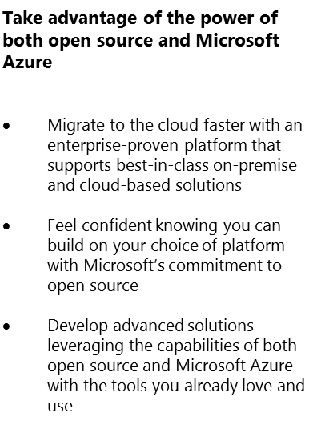
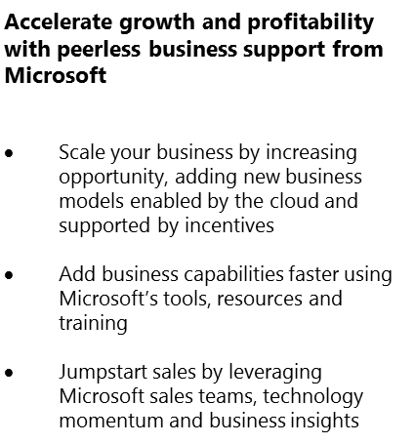
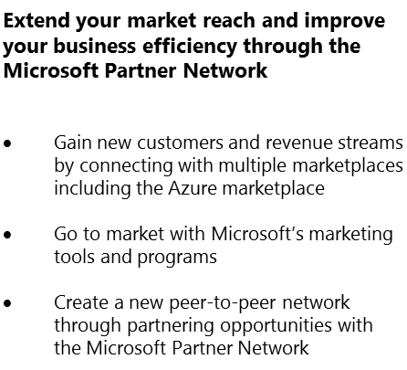
Building an Azure OSS supported business
More Empowered
Business Ready
Greater Opportunity

Slide 45





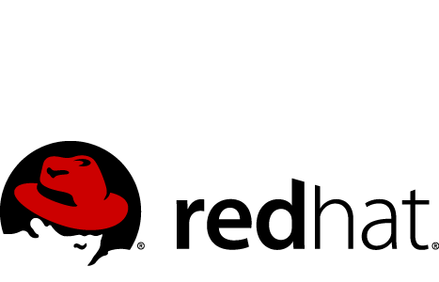


Open Source on Azure Webinar Series
- Sign up Here
Webcast | Date | Time
DevOps: Automate Your Azure Infrastructure with | March 08, 11:00am PST
DevOps: Managing Linux and Windows on Microsoft Azure with | March 22, 11:00am PST
A lap around Linux-based applications in | April 05, 11:00am PST
Big Data: Deploying Apache Hadoop​​​ with Data Platform on Azure | April 20, 11:00am PST
& Azure Container Service | May 03, 11:00am PST
Solutions on Azure besides VM management and administration | May 17, 11:00am PST
Best practices for administering hyper-scale Enterprise - built on Apache Cassandra™ - deployments in Azure | May 31, 11:00am PST
Faster delivery with : Containers as Service on Microsoft Azure | June 14, 11:00am PST

Slide 46
New Linux on Azure certification
What is it?
Microsoft Certified Solutions Associate (MCSA) Linux on Azure certification
Created in conjunction with the Linux Foundation
Designed to support evolving skills requirements among SysAdmins and to drive further opportunity in the cloud.
For More information and how to obtain the MCSA-Linux:
Visit our learning site: https://www.microsoft.com/en-us/learning/mcsa-linux-azure-certification.aspx
70-533 by MS
+
LFCS by LF
=

Slide 47


Where to get more information?
From Red Hat:
Partnership Overview: http://www.redhat.com/en/partners/strategic-alliance/microsoft
Cloud Access: http://www.redhat.com/en/technologies/cloud-computing/cloud-access
Customer Portal: http://access.redhat.com/ecosystem/partners/ccsp/microsoft-azure
How to configure CloudForms for Azure: http://red.ht/1RMFSf6
From Microsoft:
Azure + Red Hat Overview: https://azure.microsoft.com/campaigns/redhat
Red Hat Enterprise Linux now available in the Azure Marketplace: https://azure.microsoft.com/en-us/blog/more-open-source-innovation-azure/
Azure Open Source Hub: azure.com/opensource
Azure Free Trial: https://azure.microsoft.com/trial/free-trial-open-source/
Openness Blog
Read about the latest developments and momentum
http://openness.microsoft.com/blog
Microsoft Openness
Learn more about our commitment to embracing Open Source
For additional questions and for more information send e-mail to opensource@microsoft.com
http://www.microsoft.com/Openness
Notes:
47

Slide 48
Q&A

Slide 49
Thank you.
Notes:
49

Slide 50












Azure OSS Dev Ops Ecosystem
People | Process | Tools
01
02
03
04
Workstations - On-Premises | Hybrid | Cloud
Services - On-Premises | Hybrid | Cloud
Environments - On-Premises | Hybrid | Cloud
Monitoring - On-Premises | Hybrid | Cloud
Developer Workstation
Build/CI
Configuration
Monitor
Develop
Build & Test
Deploy
Monitor & Learn
Release
Team Collaboration
Test
This graphic shows OSS and partner products that are integrated with the Microsoft DevOps solution

Slide 51
Containers vs. VM’s
Virtual Machines
Each VM has independent, full OS
Full isolation
Separate app frameworks
Support features such as live migration
Containers
Shared Host OS
Near instant start-up
Processes in containers are isolated
Dependent app services and libraries are tied to container (layers)
All containers on a host will share the same guest OS version
App
A
App
A
App
B
App
C
VM
App
Framework
App
Framework
App
Framework
App
Framework
Guest OS
Guest OS
Guest OS
Guest OS
Hypervisor
Physical Server
App
A
App
A
App
B
App
B
App
C
App
C
Container
App
Framework
App
Framework
App
Framework
Guest OS w/ Docker
Hypervisor
Physical Server

Slide 52

Docker Integration Joint strategic investments to drive containers forward
Notes:
Docker has done a fantastic job of building a vibrant open source ecosystem based on Linux container technologies, providing an easy user experience to manage the lifecycle of containers drawn from a huge collection of open and curated applications in Docker Hub. We will bring Windows Server containers to the Docker ecosystem to expand the reach of both developer communities.
As part of this, Docker Engine for Windows Server containers will be developed under the aegis of the Docker open source project, where Microsoft will participate as an active community member. Windows Server container images will also be available in the Docker Hub alongside the huge number of Docker images for Linux already available.
Finally, we are working on supporting Docker client natively on Windows Server. As a result, Windows customers will be able to use the same standard Docker client and interface, for management, on multiple development environments

Slide 53



Azure Container Service
Swarm Compose
Marathon
Public Cloud
Private Cloud
Streamlined provisioning of Apache Mesos Clusters
Layered support of Swarm, Marathon, and Chronos
Docker tooling and API support
Integrated app management and scaling
Linux and Windows Server containers
Public and Private cloud

Slide 54
Cloud is a new way to think about your datacenter
Traditional model
Dedicated infrastructure for each application
Purpose-built hardware
Distinct infrastructure and operations teams
Customized processes and configurations
Cloud model
Loosely coupled apps and micro-services
Industry-standard hardware
Service-focused DevOps teams
Standardized processes and configurations
Servers
Services
Notes:
Traditional model - Empathize, land the case for change based on change in business context
Take empathizing tone (don’t want to make this sound negative). We want them to realize that what customers have done may have worked in the past but they need to recognize the need for change as the business is changing rapidly.
Most companies are running custom apps that are stitched together, they have purpose-built hardware to think about, and have specialized teams, and everything has been carefully customized (over many years in some cases!).
Now as an enterprise, you did all this for all the right reasons, but you might consider that it might be holding our customers (and their business) back in many ways given that the business context has changed fundamentally. In this new age of apps, the old way of doing this is causing friction because IT isn’t moving as fast as business wants it to.
This is manifested in developers not getting the speed and freedom they need to create the best end-user experiences. That leads to lost productivity on their side, which results in ‘Shadow IT’. In 2015, 42% of the technology budget resides outside IT; this will grow to 50% by 2020 (Gartner). So this is real.
And we all know that while Shadow IT behaviors provide immediate gratification, it comes with risk.
Slide 8: Cloud model (Mark) – Empathize, ask customers to be change agents, land cloud principles.
Now let’s look at the cloud.
Everyone knows that the cloud offers agility and innovation. It’s proving itself to be the way forward for the modern enterprise and we’ll talk more about that in a bit.
But for some of our IT customers, the cloud might seem a little daunting.
They might be asking, “Is this something I want to lead the charge on? How does it help my career?”
The tension some of them experience is because you’re not sure if things are consistent with what you’re doing on-premises and it seems like it will be hard to manage.
There’s also a tension between developers who want speed and freedom (represented by business demands), and the IT folks who have to worry about things like security and compliance.
Bridge to our POV while bringing them along. Implore them to be change agents in their orgs.
But make no mistake about it – the cloud is the natural way forward for the rapidly evolving enterprise. Let’s all embrace it. In this context, we’re already seeing some leading indicators around “bi-modal“ IT among you: 45% of CIOs have a second, fast, mode of service delivery that complements their rock solid operations” (Gartner Symposium, Oct 2014). So there’s already some great progress that a lot of you seem to be driving. This is do-able. And we want our customers to be change agents in driving cloud adoption in your orgs.
Our POV
We believe that cloud is a model/architecture, not a location.
(Cloud-first principles as in the slide)
Turns out that Microsoft has been on its own cloud-first journey for many years and we have fully operationalized cloud-first in our hyper-scale datacenters. We’d like to share some of that next to help customers shortcut their journey.

Slide 55




Cloud is a New Way to Think About Your Datacenter
Virtual Machines
Scale Sets
Container Service
Service Fabric
Windows and Linux
.Net, Java, Python, PHP, Ruby, GO, NodeJS
Docker Swarm
Mesos, etc.,
Cloud Foundry,
Marathon, Deis, OpenShift etc.
Azure is open at every layer
System Administrator
Azure Resource Manager
Developer

Slide 56























































Platform Services
Security & Management
Services Compute
Web and Mobile
Data
Hybrid
Operations
Stateless
Compute
Distributed
Compute
Web Apps
Infrastructure
API App
Infrastructure
Service Creation
& Configuration
Relational
SQL Database
Data
Warehouse
Document
Database Service
Directory
Health Monitoring
User/Group Directory Store
Scheduled Compute Jobs
Virtual App
Streaming
Privileged
Identity
Management
Mobile
Backends
Business Process
Automation
Distributed
In-Memory
Cache
Search
Simple
Key/Value
Store
Identity Sign-Up and sign-in
Domain Join &
Policy Management
Integration
Multi-Factor
Authentication
API
Management
Push
Notifications
Simple
Queuing
B2B
Integration
Analytics & IoT
Server Data Backup
Scheduled Service Management
Hybrid
Connections
Pub/Sub
Queuing
Developer Services
Big Data
Analytics
Predictive
Analytics
Data Stream
Analytics
Big Data
Storage
Operational
Analytics
Task
Scheduler
Encryption Key
Store
Development
Tools
Software
Development
Kits
Data
Pipelines
Device Data
Collection
Data Source
Management
Bulk Data Import
And Export
Media & CDN
Software/Solution Marketplace
Live & OD
Media Streaming
Content Delivery
Network (CDN)
Software Lifecycle
Management
Application
Instrumentation
IoT Device
Management
Mobile
Analytics
Disaster
Recovery
Pre-Build VM
Images
Hybrid/Intelligent
Data Backup
Infrastructure Services
OS/Server Compute
Storage
Networking
Virtual Servers
Containers
Disk based Object/File Storage
Shared
Storage
SSD based Object/File Storage
Virtual Network
VM Load Balancer
DNS
Direct
Network
Connections
Traffic Distribution
VPN Gateway
HTTP Load Balancer
Datacenter Infrastructure (30 Regions, 22 Online)
Notes:
Why this Slide:
This is the same as the previous slide except that the names are not service names, they represent IT Capabilities…

Slide 57
Platform Services
Security & Management
Services Compute
Web and Mobile
Data
Hybrid
Operations
Cloud
Services
Service
Fabric
Web Apps
API Apps
Portal
SQL
Database
Data
Warehouse
DocumentDB
Azure AD
Health Monitoring
Azure Active
Directory
Batch
RemoteApp
AD Privileged
Identity
Management
Mobile
Apps
Logic Apps
Redis
Cache
Azure
Search
Storage
Tables
Azure AD
B2C
Integration
Domain Services
Multi-Factor
Authentication
API
Management
Notification
Hubs
Storage
Queues
BizTalk
Services
Analytics & IoT
Backup
Automation
Hybrid
Connections
Service Bus
Developer Services
HDInsight
Machine
Learning
Stream
Analytics
Data
Lake
Operational
Analytics
Scheduler
Key Vault
Visual Studio
Azure
SDK
Data
Factory
Event
Hubs
Data
Catalog
Import/Export
Media & CDN
Store/
Marketplace
Media Services
Content Delivery
Network (CDN)
VS Online
App
Insights
Mobile
Engagement
Azure Site
Recovery
IoT Hub
VM Image Gallery
& VM Depot
StorSimple
Infrastructure Services
OS/Server Compute
Storage
Networking
Virtual Machines
Container
Service
BLOB Storage
Azure
Files
Premium
Storage
Virtual Network
Load Balancer
DNS
Express
Route
Traffic Manager
VPN Gateway
App
Gateway
Datacenter Infrastructure (30 Regions, 22 Online)
Notes:
Why this Slide:
It shows we have a very broad platform. It about BOTH IaaS and PaaS, that these work together. It shows that we continue to lead in world class IT capabilities and that there’s really nothing missing.
Key Points:
We have already seen how the Azure Platform is IaaS + Pass – but I want you to understand that this is a huge number of capabilities – IT building blocks if you will.
Every one of these blocks you provision anytime, self-service anywhere in the world 24x7. You pay for what you use, you can get more or less anytime and you can fully automate everything…

Slide 58
Microsoft Azure Stack is a new hybrid cloud platform product that enables organizations to deliver Azure services from their own datacenter thereby helping them achieve more.
Azure Stack
The Power of Azure in Your Datacenter

Slide 59
What does a hybrid cloud platform look like?
End-user experiences
Cloud application model
Infrastructure services
Platform services
Cloud infrastructure
Private | Hosted | Public
Notes:
Slide purpose: This is a product agnostic slide, it helps frame the hybrid cloud platform category – i.e. the notion of ONE consistent platform in a hybrid context.
A hybrid cloud platform has a standard architecture, regardless of deployment location (i.e. private, public, hosted). Due to this standard architecture, applications can be seamlessly distributed in hybrid contexts without making any code changes.
Summarize layers of the stack
End user experiences
Cloud application model
Infrastructure/Platform services
Cloud infrastructure

Slide 60
Microsoft’s hybrid cloud platform Power of Azure in your datacenter
Developers
Portal | PowerShell | Dev-ops tools
End-user experiences
Portal | PowerShell | Dev-ops tools
Azure Resource Manager
Cloud application model
Azure Resource Manager
One Azure ecosystem
Unified app development
Azure IaaS | Azure PaaS
Infrastructure services
Platform services
Azure IaaS | Azure PaaS
Compute | Networking | Storage
App Service** | Service Fabric*
Azure services in your datacenter
Cloud infrastructure
Cloud infrastructure
Cloud-inspired infrastructure
IT
Microsoft Azure
Public
Microsoft Azure Stack
Private | Hosted
TP1 = Technical Preview 1
** - Only Web Apps is in TP1, * - not in TP1
Notes:
Slide purpose: This slide does 2 things: a) puts a product-oriented lens to the cloud platform b) introduces messaging taking a developer, IT, and business lens.
Slide 19: Power of Azure in your datacenter. Let slide animate fully.
Note that Azure Stack is born of Azure.
Same end user experiences, same app model.
Same Azure IaaS and PaaS services. What you see listed in the slide is the set of services that are coming to Azure Stack in its first release (or first version).
On the infrastructure layer, we are making some translation – Azure runs on hyper-scale (each scale unit is 20 racks!) while you folks likely run a lesser footprint. So we’re doing some work to make this fit into your environments.
Three main investment areas or benefits are Azure Services in your Datacenter, Unified App Development, and One Azure Ecosystem.
We want to go through these in more detail obviously, but suffice it to say, this approach and solution builds bridges between all three schools of thought: business folks, IT and infrastructure folks like Jeffrey, and dev and cloud guys like me
As a developer, I would be excited about… Application developers can maximize their productivity using a ‘write once, deploy to Azure or Azure Stack’ approach. Using APIs that are identical to Microsoft Azure, they can create applications based on open source or .NET technology that can easily run on-premises or in the public cloud. They can also leverage the rich Azure ecosystem to jumpstart their Azure Stack development efforts.
As an IT professional, I’m going to be super happy about (moving forward in my career, pleasing my developers, etc.). IT can help transform on-premises datacenter resources into Azure-consistent IaaS and PaaS services, thereby maximizing agility and efficiency. End users can quickly provision services using the same self-service experience as Azure. IT gets to use the same automation tools as Azure to control the service delivery experience.
As a business, you can truly take advantage of cloud on your terms.

Slide 61
Azure services in your datacenter
Developers
Self-service
consumption
Transform datacenter resources into cloud services
Self-service IaaS—Virtual Machines, Virtual Network, Storage, Docker-enabled containers
Self-service PaaS— App Service**, Service Fabric*
Flexible service delivery with Azure-based management and automation tools
PaaS
PaaS
IaaS
IaaS
IT Ops
Flexible service delivery
** - Only Web Apps is in TP1, * - not in TP1
Notes:
Azure services in your datacenter
Transform on-premises datacenter resources into cloud services for maximum agility.
Run Azure infrastructure services - including Virtual Machines, Virtual Network, and Blob/Table Storage - for traditional apps like SQL Server or SharePoint.
Empower developers to write cloud-first apps using on-premises deployments of Azure App Service (Web Apps) and Docker-integrated containers.
Make developers productive with the same self-service experience as Azure.
IT gets to control on-premises Azure experience to best meet business requirements.
Hit on PaaS differentiation: – Web Apps, Docker-integrated containers
Key capabilities (not part of talking points, mentioned for completeness)
Next-gen Azure Compute – Virtual Machines, Virtual Machine Extensions (incl. support for Linux and Windows Server containers on Docker)
Next-gen Azure Networking – Virtual Network, Load Balancer, VPN Gateway
Next-gen Azure Storage – Blobs and Tables
Azure App Service
Azure portal (end-user experience)
Azure service admin portal experience for managing subscriptions, quotas, image gallery, and metering

Slide 62
Unified app development
Describe
Deploy
Control
Gallery
Write once, deploy to Azure or Azure Stack
Identical application model with same APIs
Role-based Access Control (RBAC)
Same deployment experience—PowerShell, Azure portal, or Visual Studio
Choice of open source application platforms, languages, and frameworks
Azure Resource Manager
Azure Resource Manager
Consistency
MICROSOFT AZURE STACK
MICROSOFT AZURE
Notes:
Unified app development
Build and deploy your application the same way regardless of whether it runs on Azure or Azure Stack.
Use Azure Resource Manager to build reusable application templates for traditional and cloud-native apps.
Use role-based access control in Azure Resource Manager and Azure Active Directory to enable fine-grained access to application resources.
Write to the same Azure APIs.
Use the same Azure SDK. Continue to use Visual Studio as your development canvas.
Just like in Azure, so you get a broad choice of open source technologies, including Linux, Java, and PHP.
Key capabilities (not part of talking points, mentioned for completeness)
Identical APIs and application model with Azure Resource Manager
Role-based access control with Azure Active Directory and Azure Resource Manager
Unified Azure SDK
Native Visual Studio integration
Support for application platforms, languages, and frameworks, including Linux, Java, node.js, and PHP.

Slide 63
One Azure ecosystem
Jump-start your Azure Stack efforts with the rich Azure ecosystem
Azure Resource Manager templates
Windows Server and Linux VM images
Third-party services and extensions
GitHub to store and share above application components
Notes:
One Azure ecosystem
Jumpstart your Azure Stack efforts with the rich Azure ecosystem. (Mark)
Content designed for Azure will also work with Azure Stack—be it Azure Resource Manager templates, Windows Server/Linux VM images, or third-party services. (Mark)
Use GitHub to store and share templates in the Azure Stack gallery. (Mark)
Most importantly, think about what participating in this rich cloud platform ecosystem means for your careers. You build some great skillsets and experiences to any enterprise organization that you choose to go to. (Jeffrey)
Key capabilities (not part of talking points, mentioned for completeness)
Curated Azure Resource Manager templates for SharePoint, SQL, AD
Curated gallery images for Windows Server and Linux
GitHub-based gallery

Slide 64
Azure Stack Demo

Slide 65
Platform Services
Security and Management
Compute
Web and mobile
Developer services
Hybrid
Operations
Cloud Services
Service Fabric
Web Apps
API Apps
API Management
Visual Studio
Azure SDK
Portal
Azure AD Connect Health
Active Directory
Batch
Remote App
Mobile Apps
Logic Apps
Notification Hubs
Team Project
Application Insights
AD Privileged Identity Management
Multi-factor Authentication
Integration
Analytics and IoT
Data
Backup
Automation
Storage Queues
Biztalk Services
HDInsight
Machine Learning
SQL Database
SQL Data Warehouse
Operational Insights
Key Vault
Hybrid Connections
Service Bus
Data Factory
Event Hubs
Redis Cache
Search
Import/Export
Store/ Marketplace
Media and CDN
Site Recovery
Stream Analytics
Mobile Engagement
DocumentDB
Tables
VM Image Gallery and VM Depot
Media Services
Content Delivery Network (CDN)
StorSimple
Infrastructure Services
Compute
Storage
Networking
Virtual Machine
Containers
BLOB Storage
Azure Files
Premium Storage
Virtual Network
Load Balancer
DNS
Express
Route
Traffic Manager
VPN Gateway
Application Gateway
Legend
= In preview at Azure Stack GA
Notes:
This drives clarity against which Azure capabilities – including core services, infrastructure services, platform services - will come to Azure Stack at GA timeframe. Click through these and walk through them.

Slide 66

Write once, deploy any Microsoft Cloud
Virtual machines
Containers
Azure Service Fabric
Linux
Azure Resource Manager
Microsoft Azure Stack
Microsoft Azure

Slide 67


Microsoft hybrid IT management
Simplified guest and workload management, both on-premises and in the cloud
Microsoft
Operations Management Suite
HYPER-V
LINUX
HYPER-V
LINUX
WINDOWS
WINDOWS
VMware
LINUX
VMware
LINUX
WINDOWS
WINDOWS
Public cloud
Azure or AWS
Private or hosted third-party cloud,
Rackspace, etc.
HYPER-V
LINUX
WINDOWS
WINDOWS
VMWare
LINUX
WINDOWS
LINUX
On-premises with System Center

Slide 68


Slide 69



Hyper scale Infrastructure is the enabler
100+ Datacenters across 30 Regions (22 Generally Available) Worldwide
North Central US
Illinois
We add more servers every day than the total number of servers we added in all of 2011
United Kingdom
Regions
West Europe
Netherlands
Canada Central
Toronto
United Kingdom
Regions
Central US
Iowa
Canada East
Quebec City
Germany North East **
Magdeburg
US Gov
Iowa
China North *
Beijing
US DoD West
TBD
North Europe
Ireland
Germany Central **
Frankfurt
China South *
Shanghai
Japan East
Tokyo, Saitama
East US
Virginia
West US
California
India Central
Pune
Japan West
Osaka
East US 2
Virginia
US Gov
Virginia
India South
Chennai
South Central US
Texas
India West
Mumbai
East Asia
Hong Kong
US DoD East
TBD
SE Asia
Singapore
Australia East
New South Wales
Brazil South
Sao Paulo State
Australia South East
Victoria
Top 3 networks in the world
2.5x AWS, 7x Google DC Regions
G Series – Largest VM in World, 32 cores, 448GB Ram, SSD…
Operational
Announced/Not Operational
* Operated by 21Vianet ** Data Stewardship by Deutsche Telekom

